Slide 1

Star Wars website
Felipe .M Iglesias

Slide 2


DESIGN

Slide 3
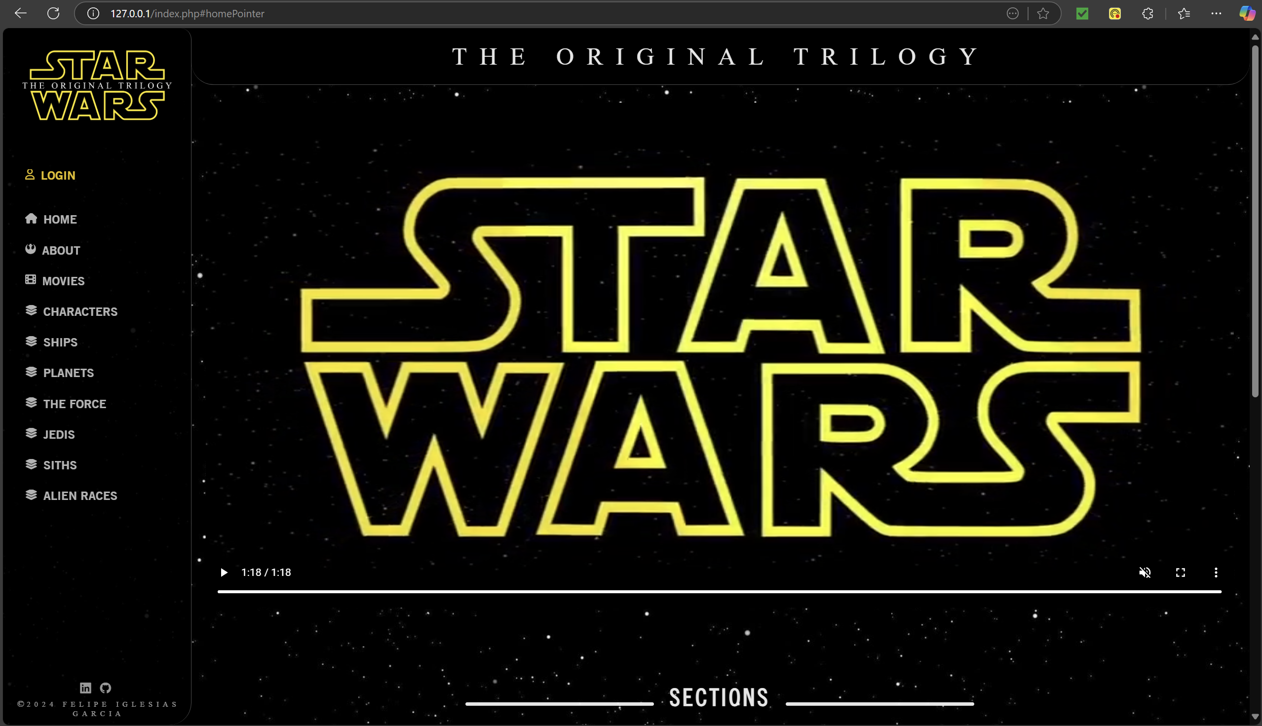
Right side nav bar to locate all sections very easy as users can read quicker if elements are in a vertical display
Good Contrast

Slide 4
CTA video

Slide 5
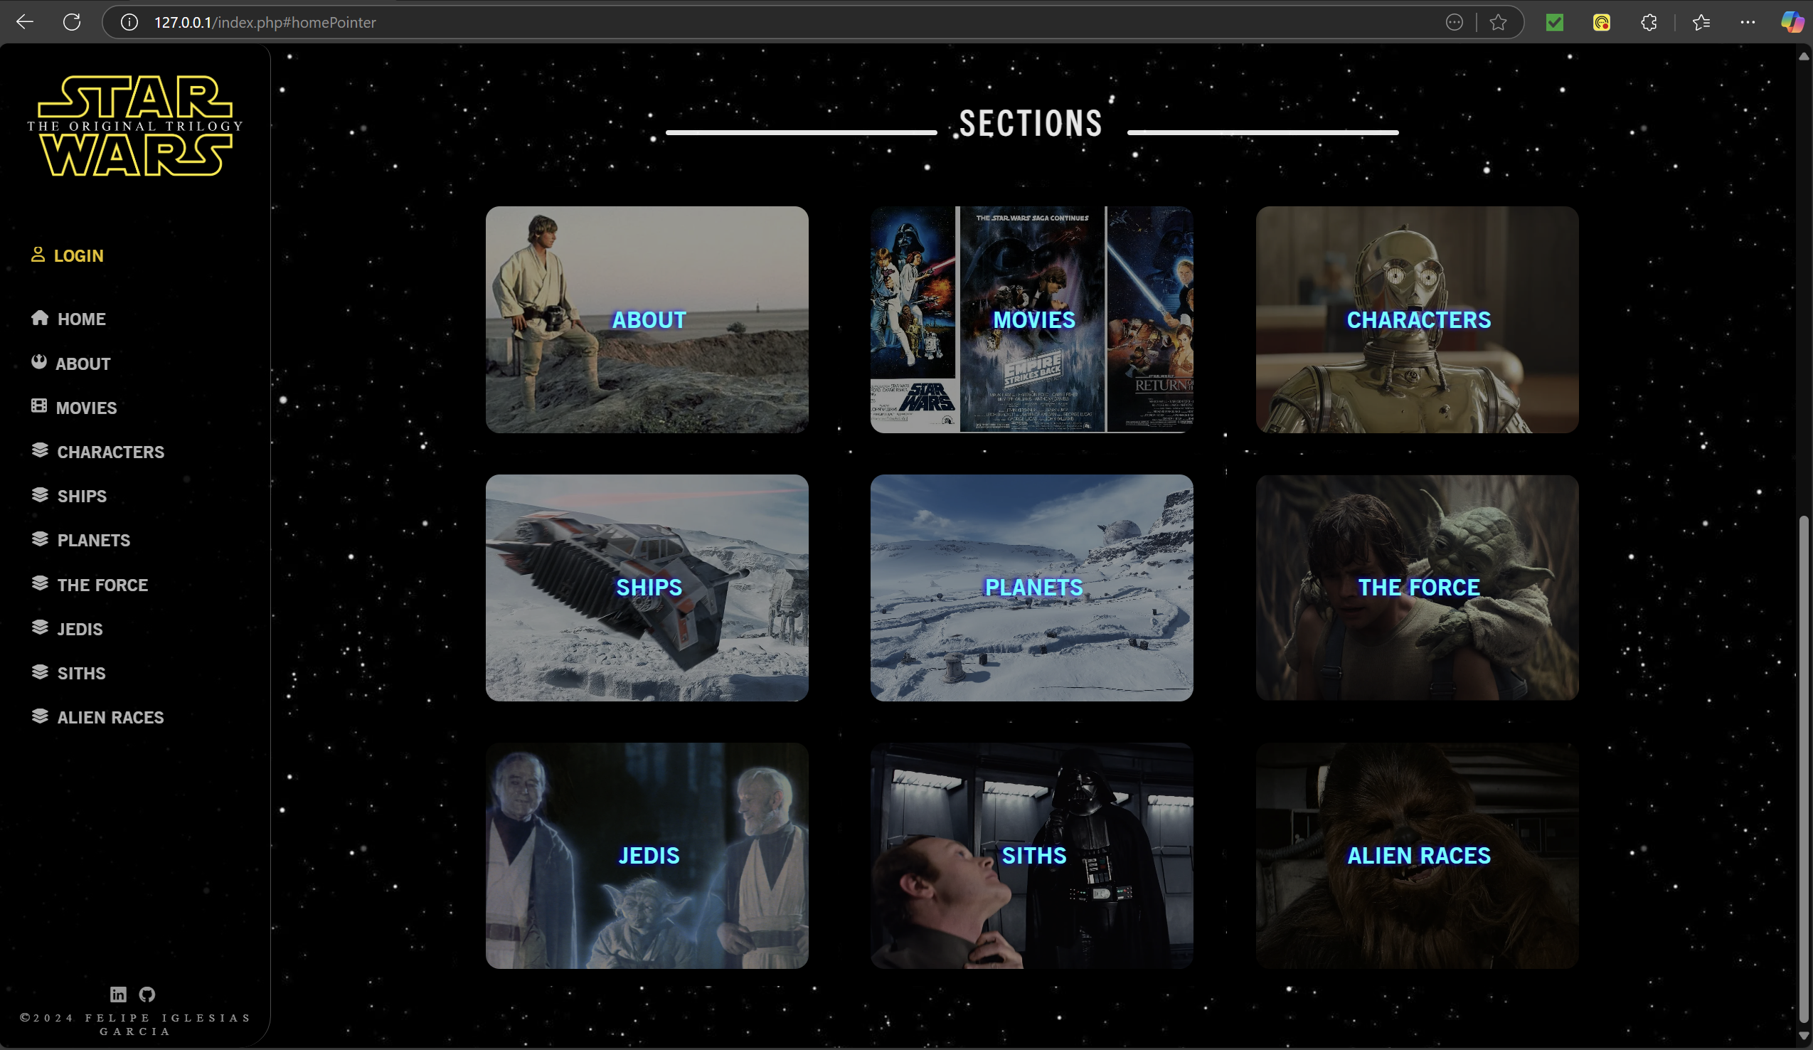
Grid to access all section when going back to home

Slide 6
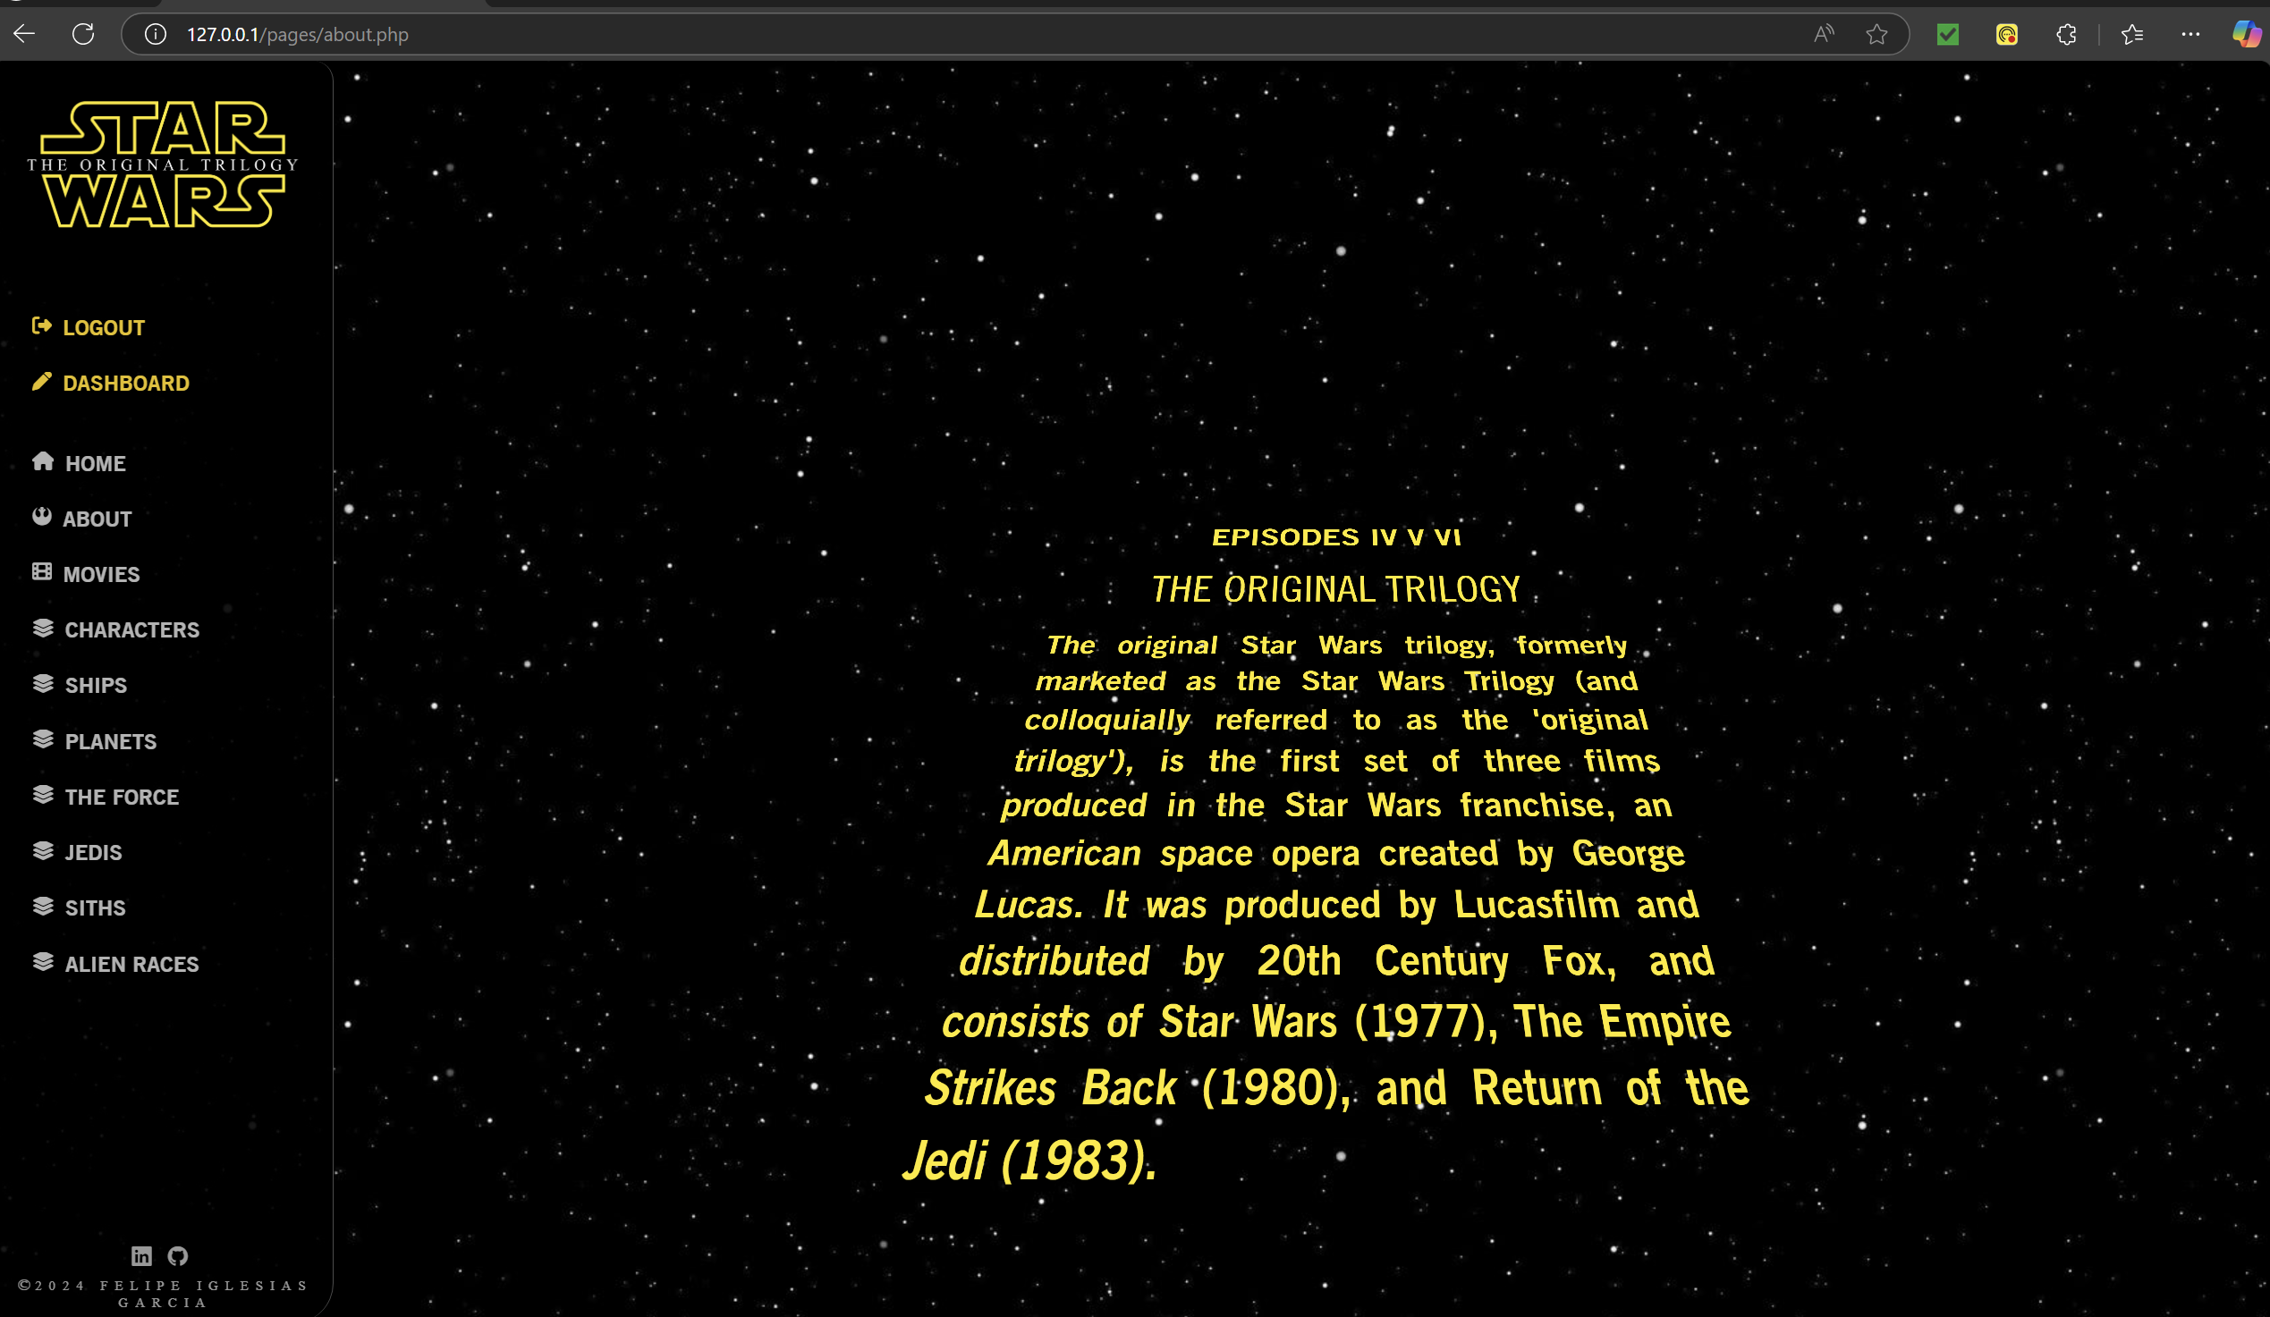
about.php
JavaScript Crawling letters animation

Slide 7
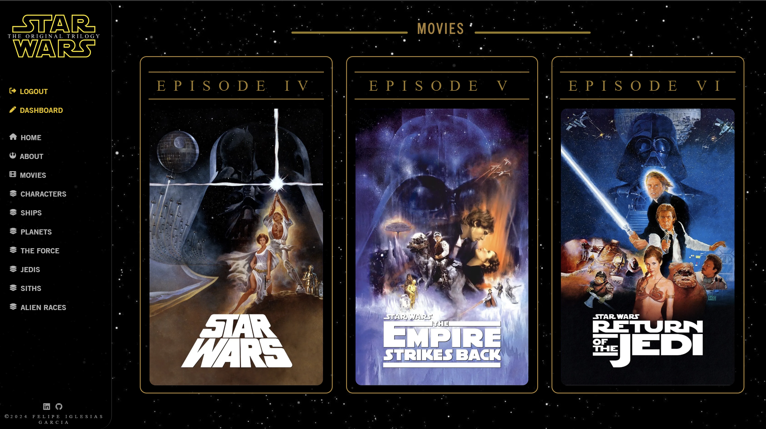

Slide 8
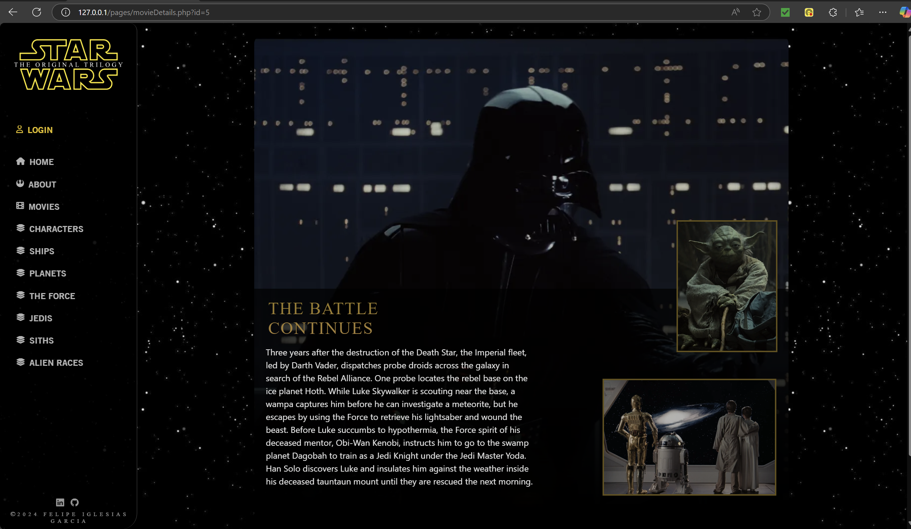
movieDetails.php
Background Image
Images
Introduction Subtitle
Synopsis

Slide 9
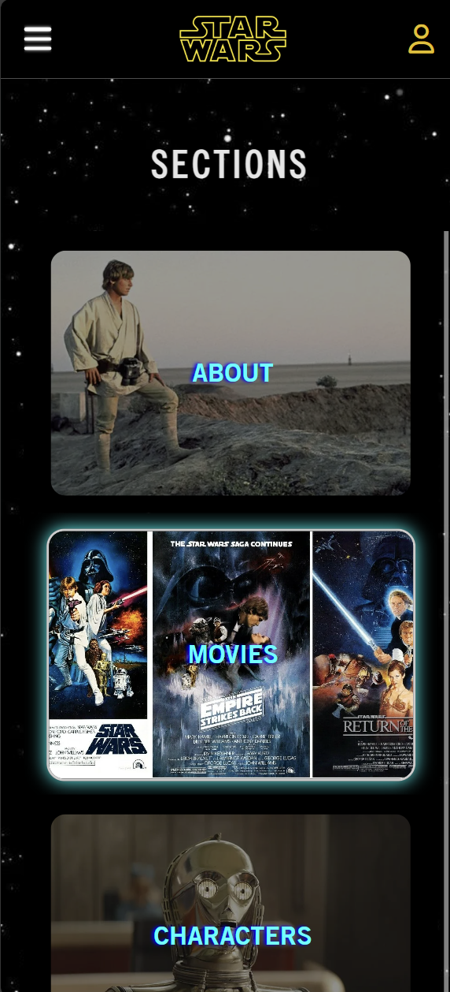
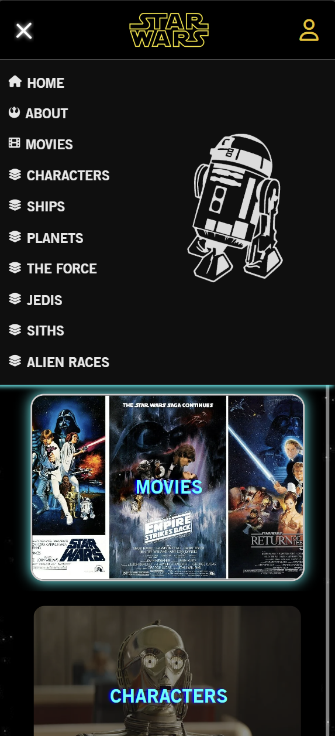
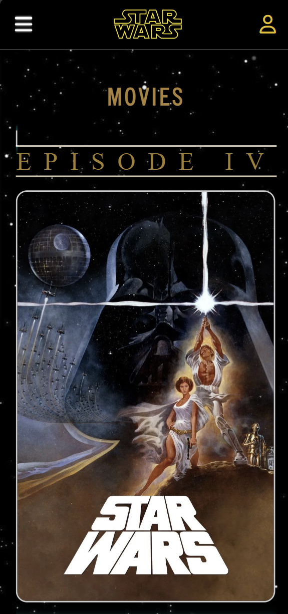
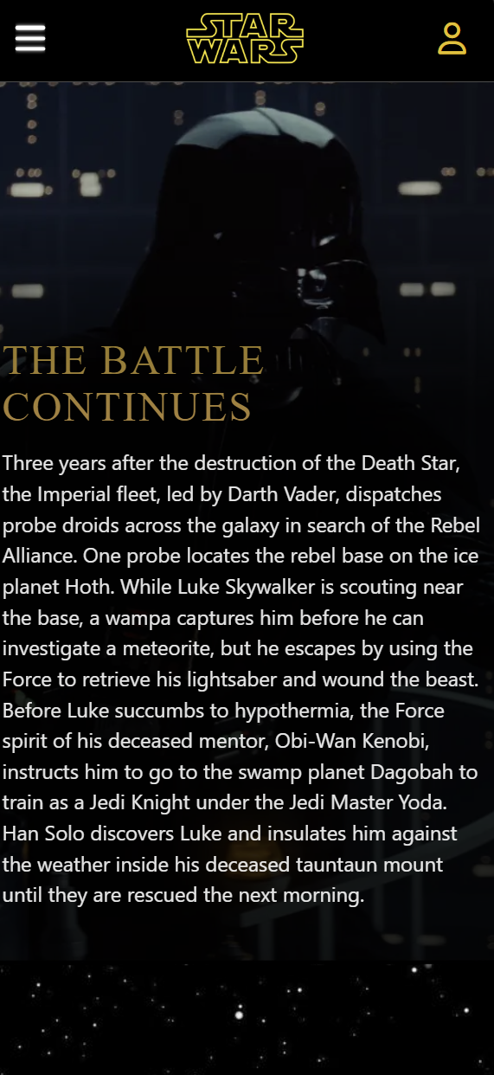
Mobile view
Responsive Nav Bar
Model: iPhone 16

Slide 10
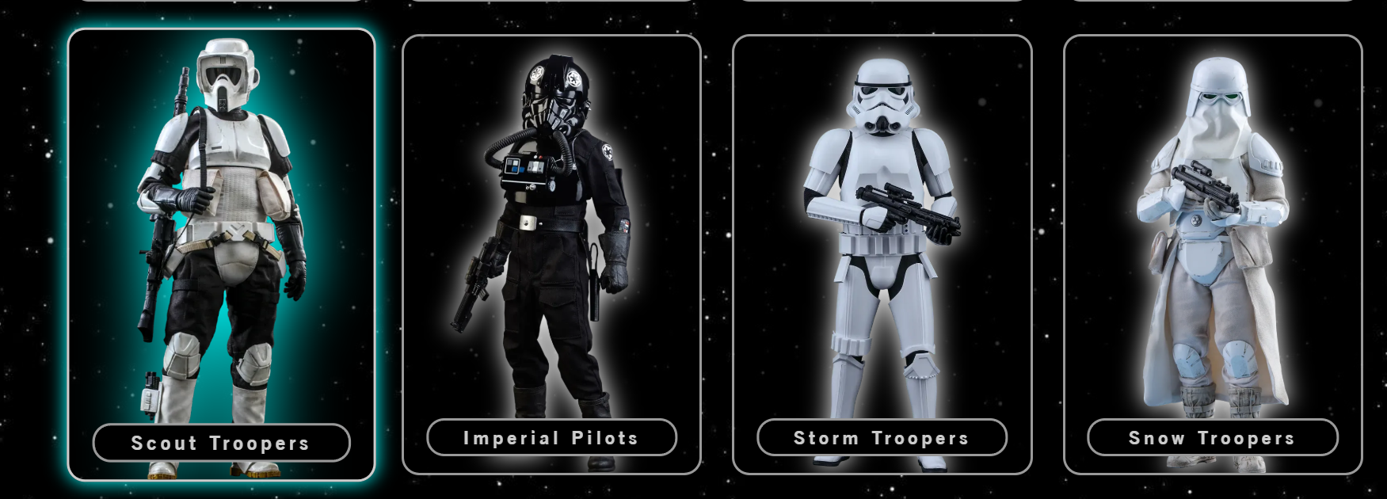
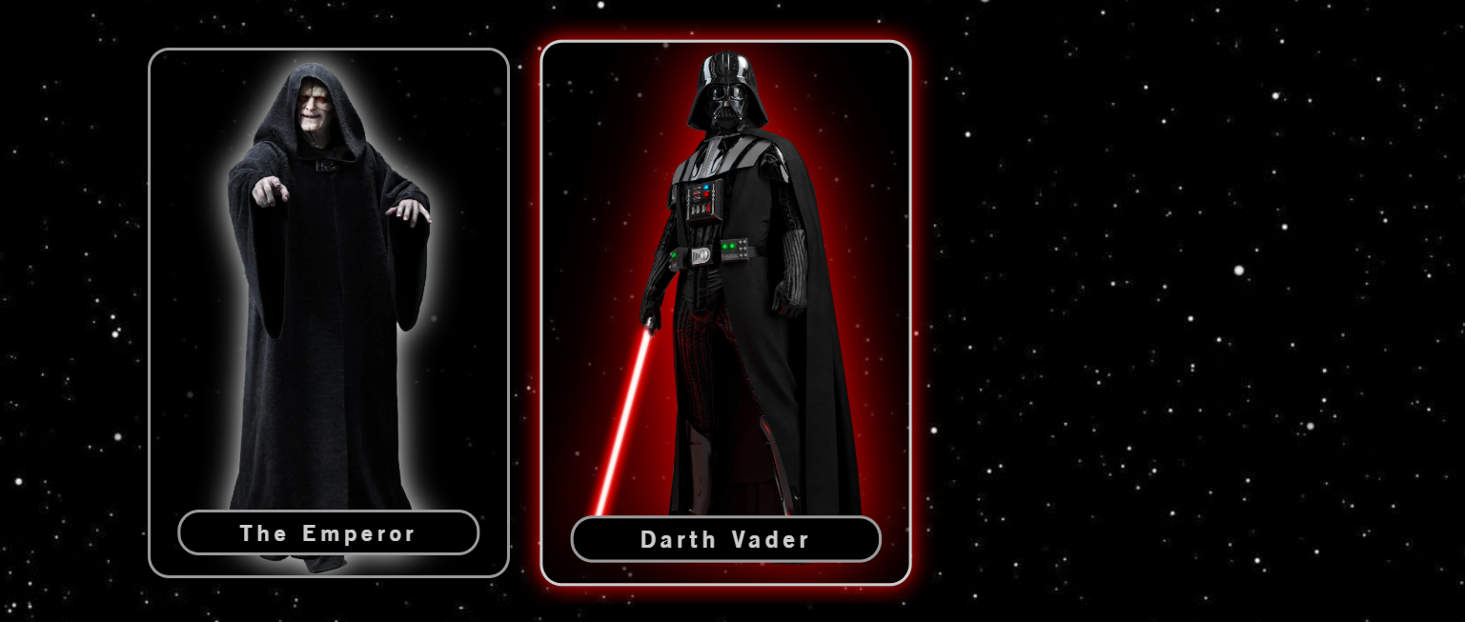
Hover effect
rgb(0, 255, 255)) that match with the Star Wars theme when user can interact with elements.
rgb(255, 0 , 0)) for the Siths section

Slide 11
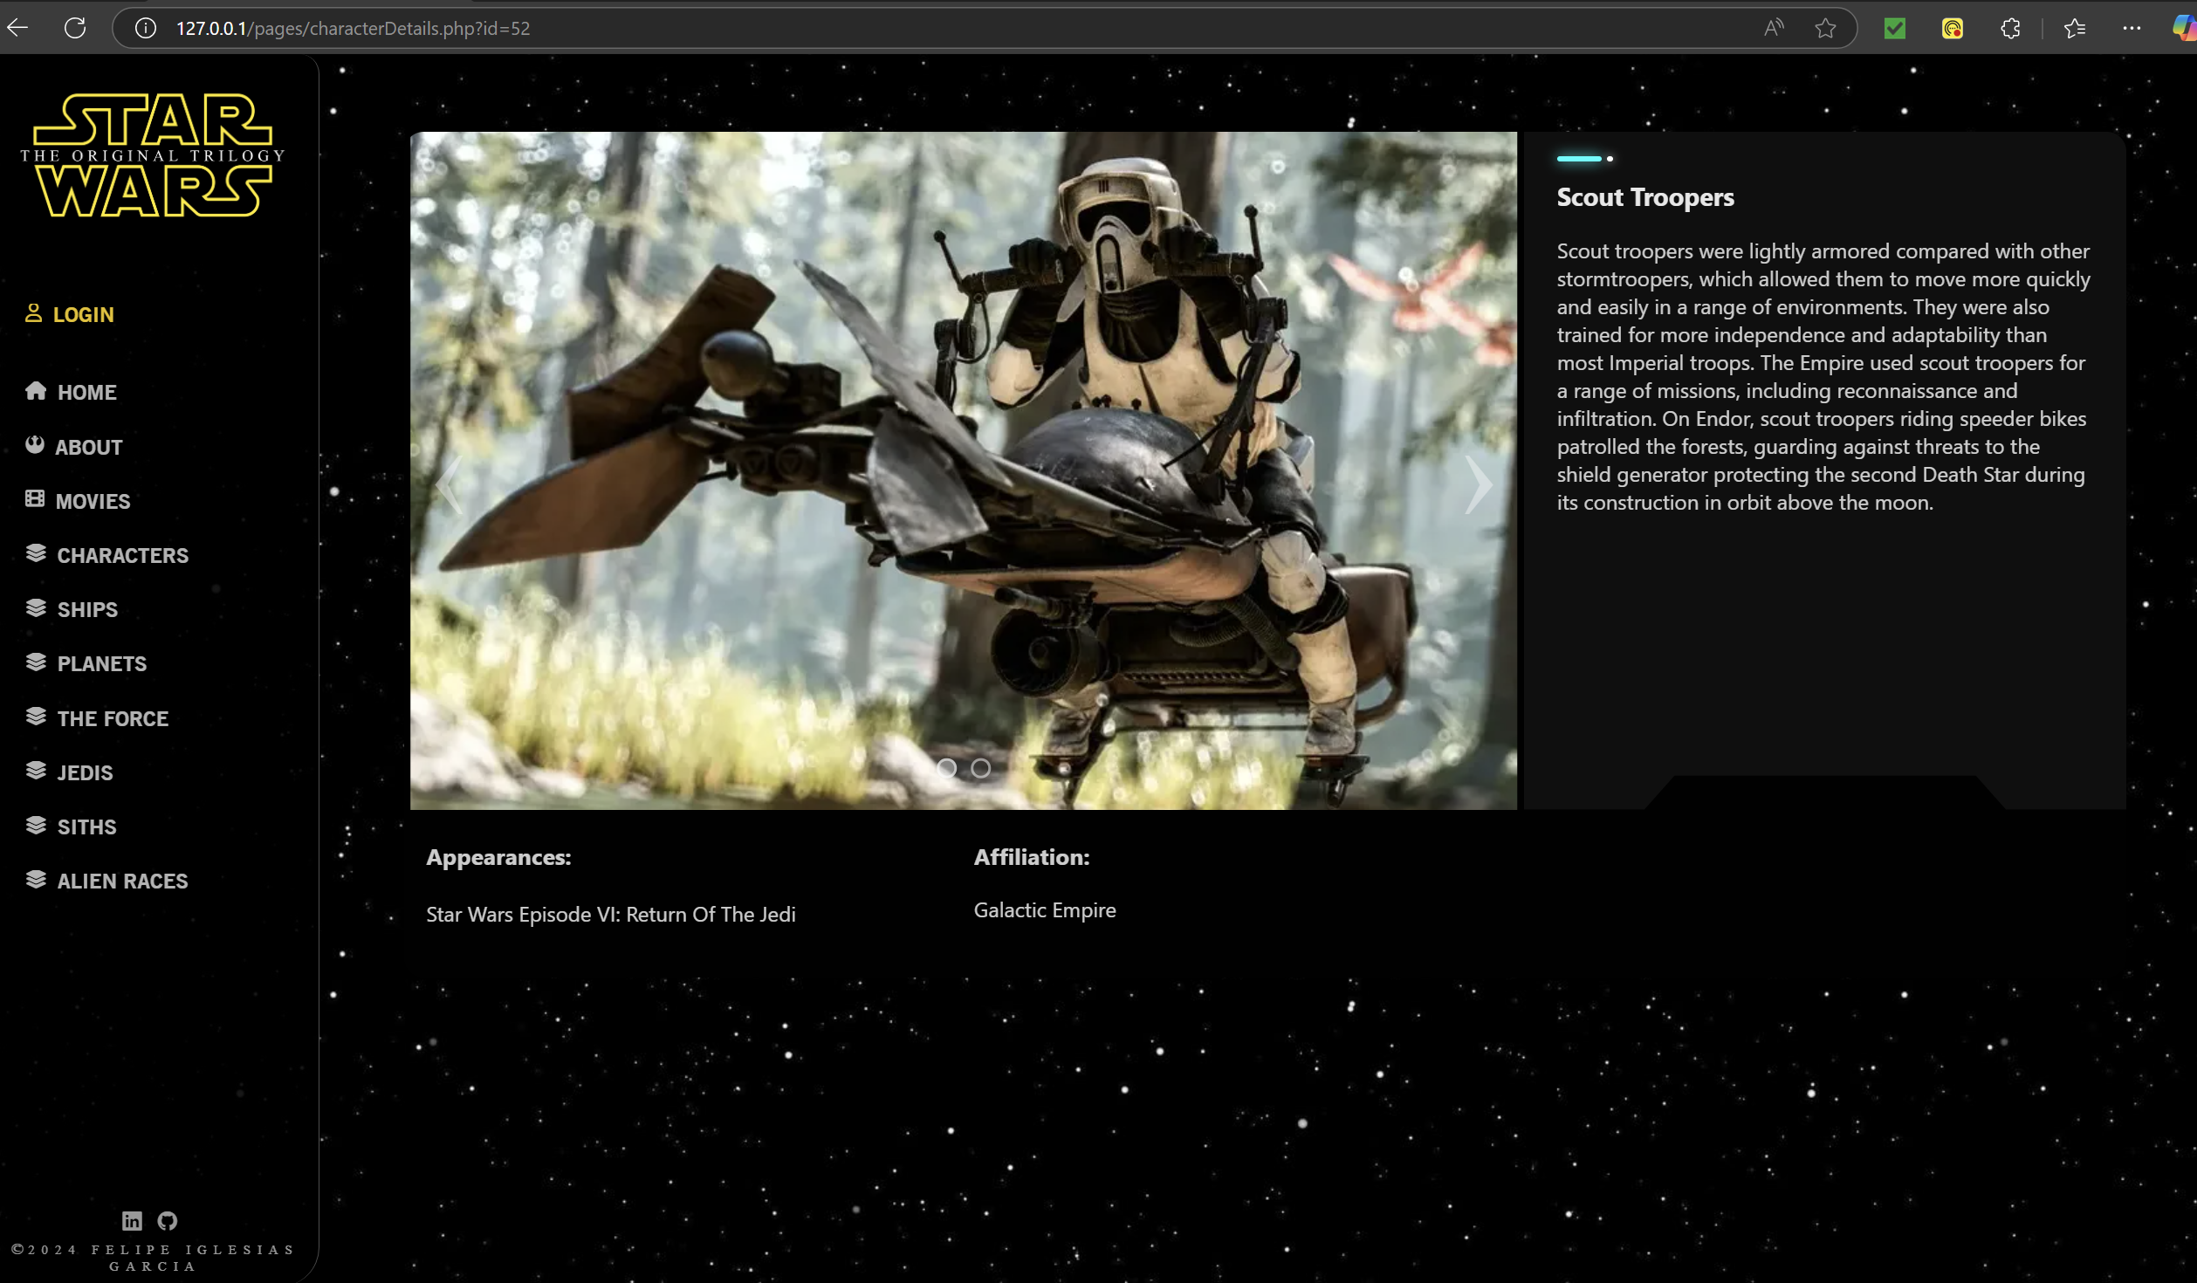
Slideshows
Slideshows to move left and right between images. After 6s it will go to the next one automatically.

Slide 12
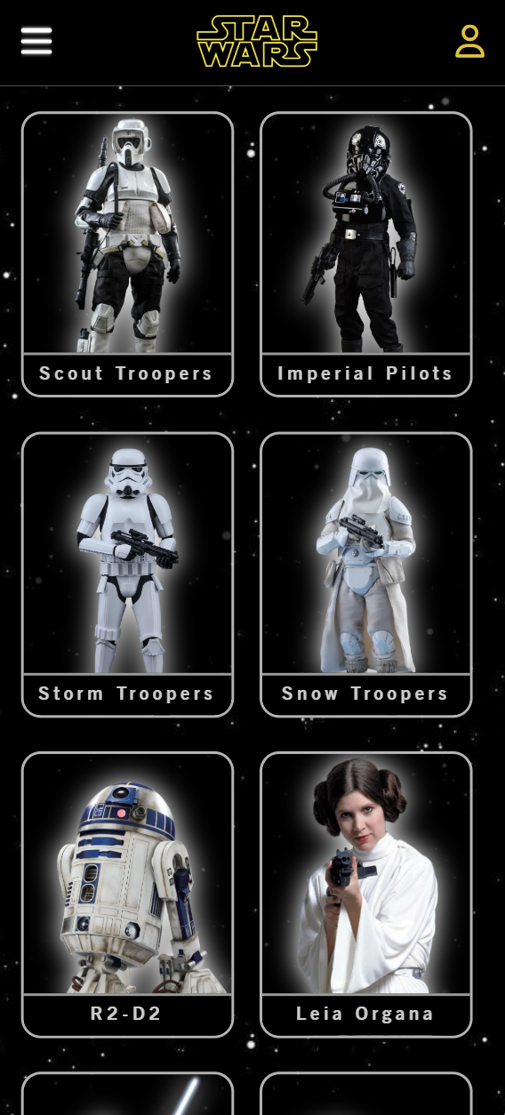
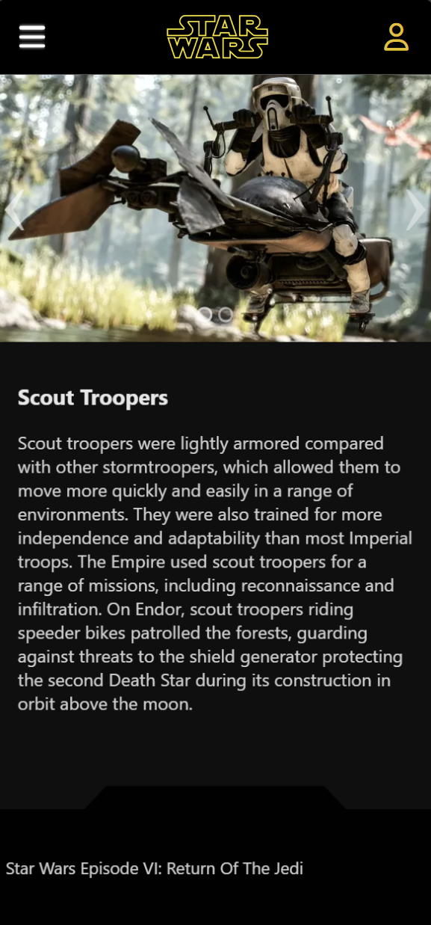
Mobile view
Model: iPhone 16

Slide 13
FUNCTIONALITY

Slide 14
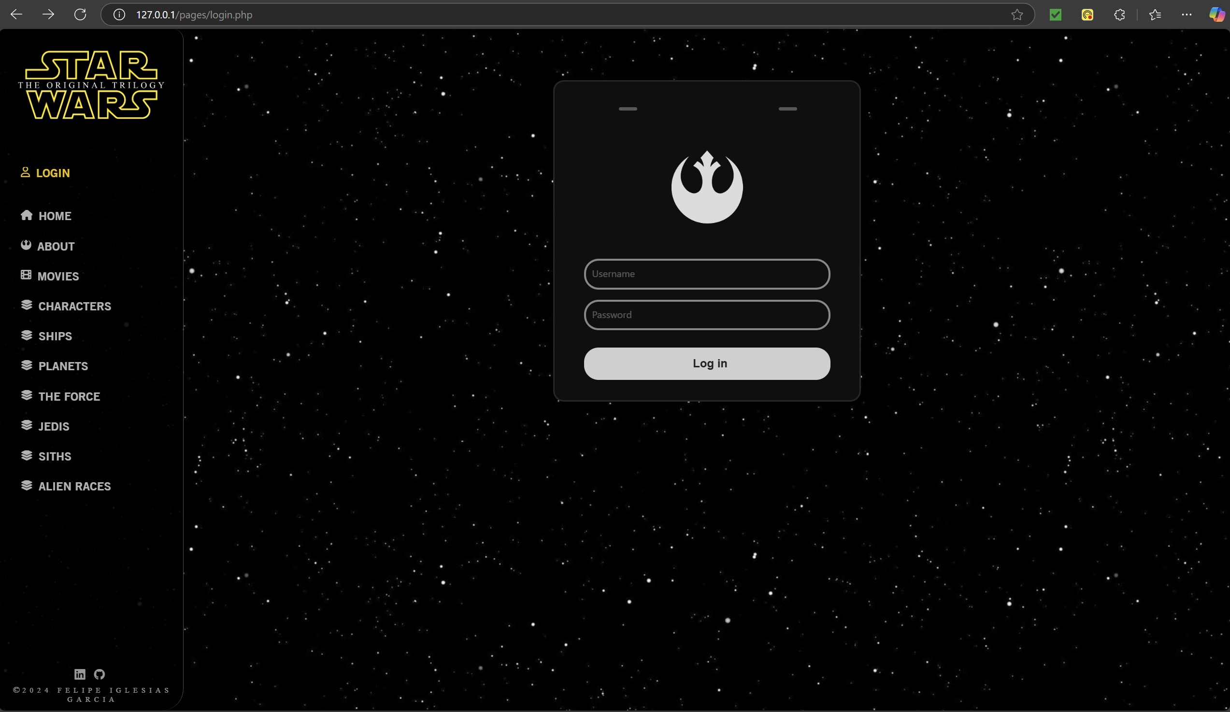

Slide 15
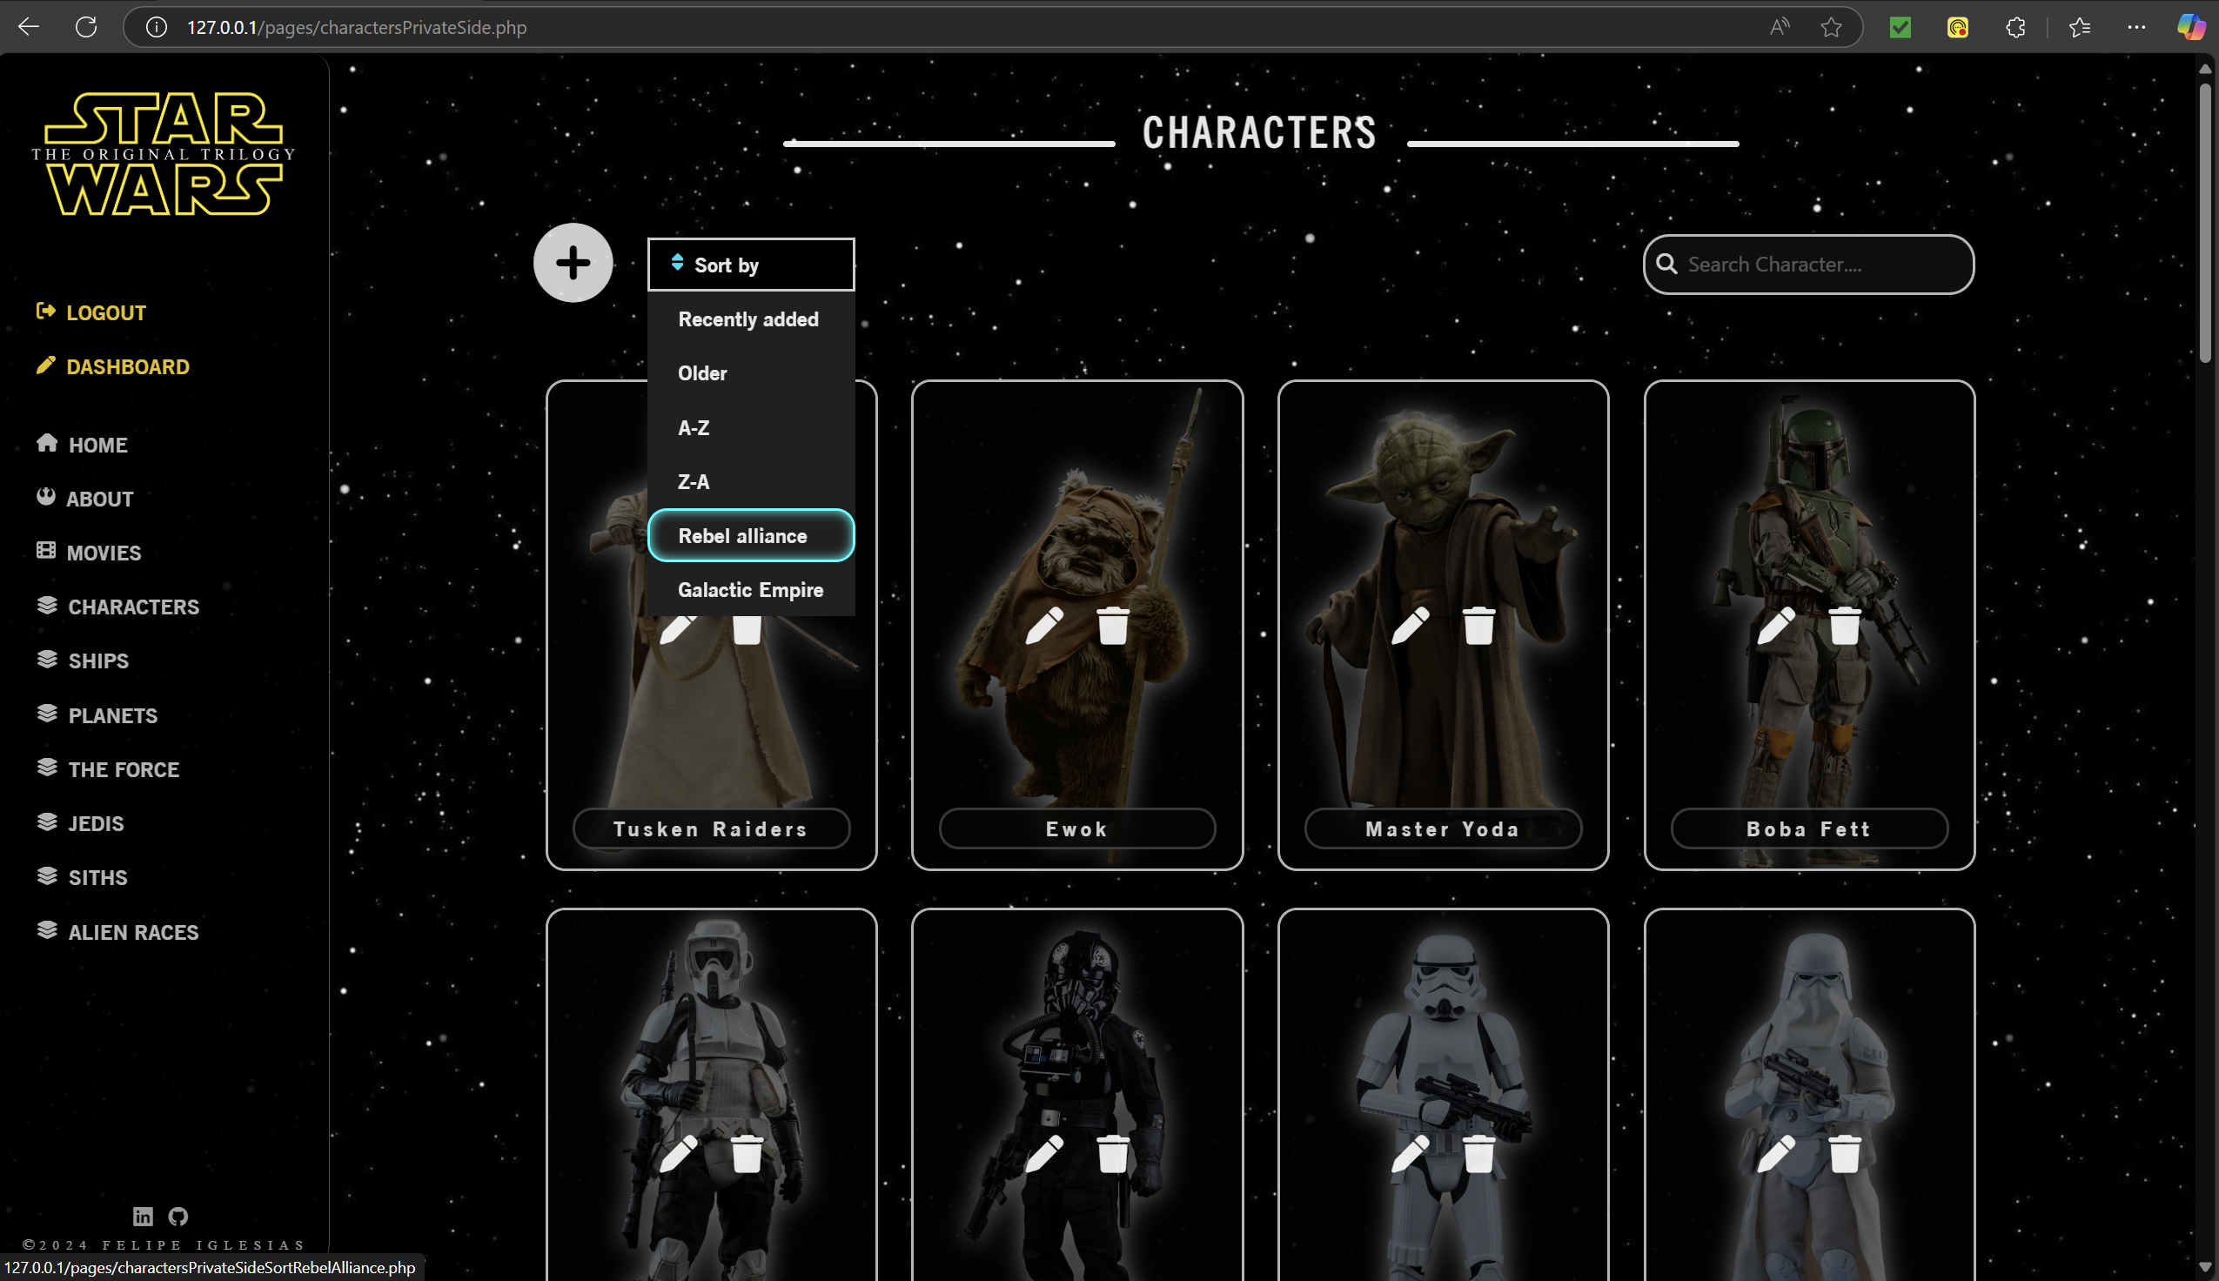
Private view
Big icon to easily find the way to insert data
Search bar for a quick data search
Icons to have an intuitive way to edit data
Dropdown menu to sort the data by different categories

Slide 16
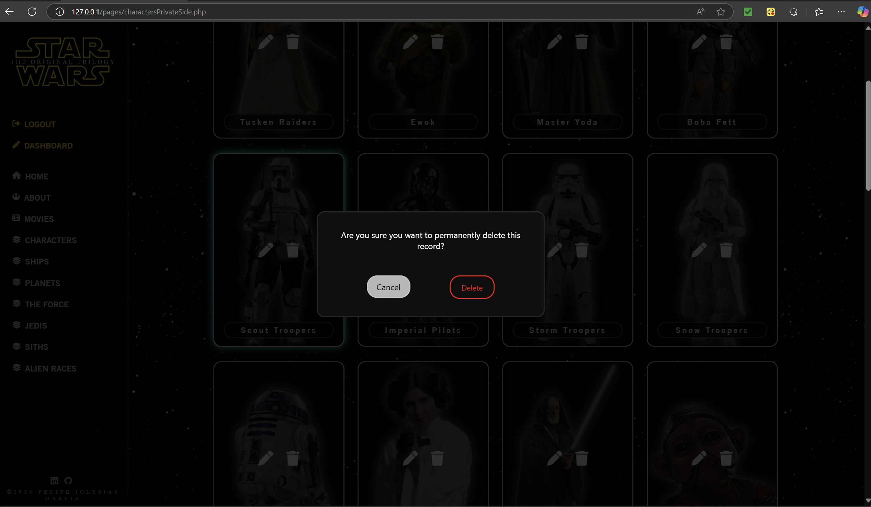
Delete view

Slide 17
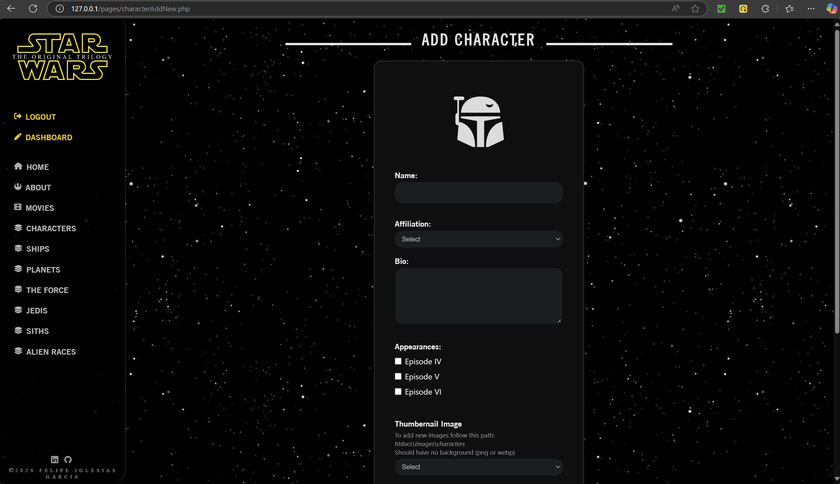

Slide 18
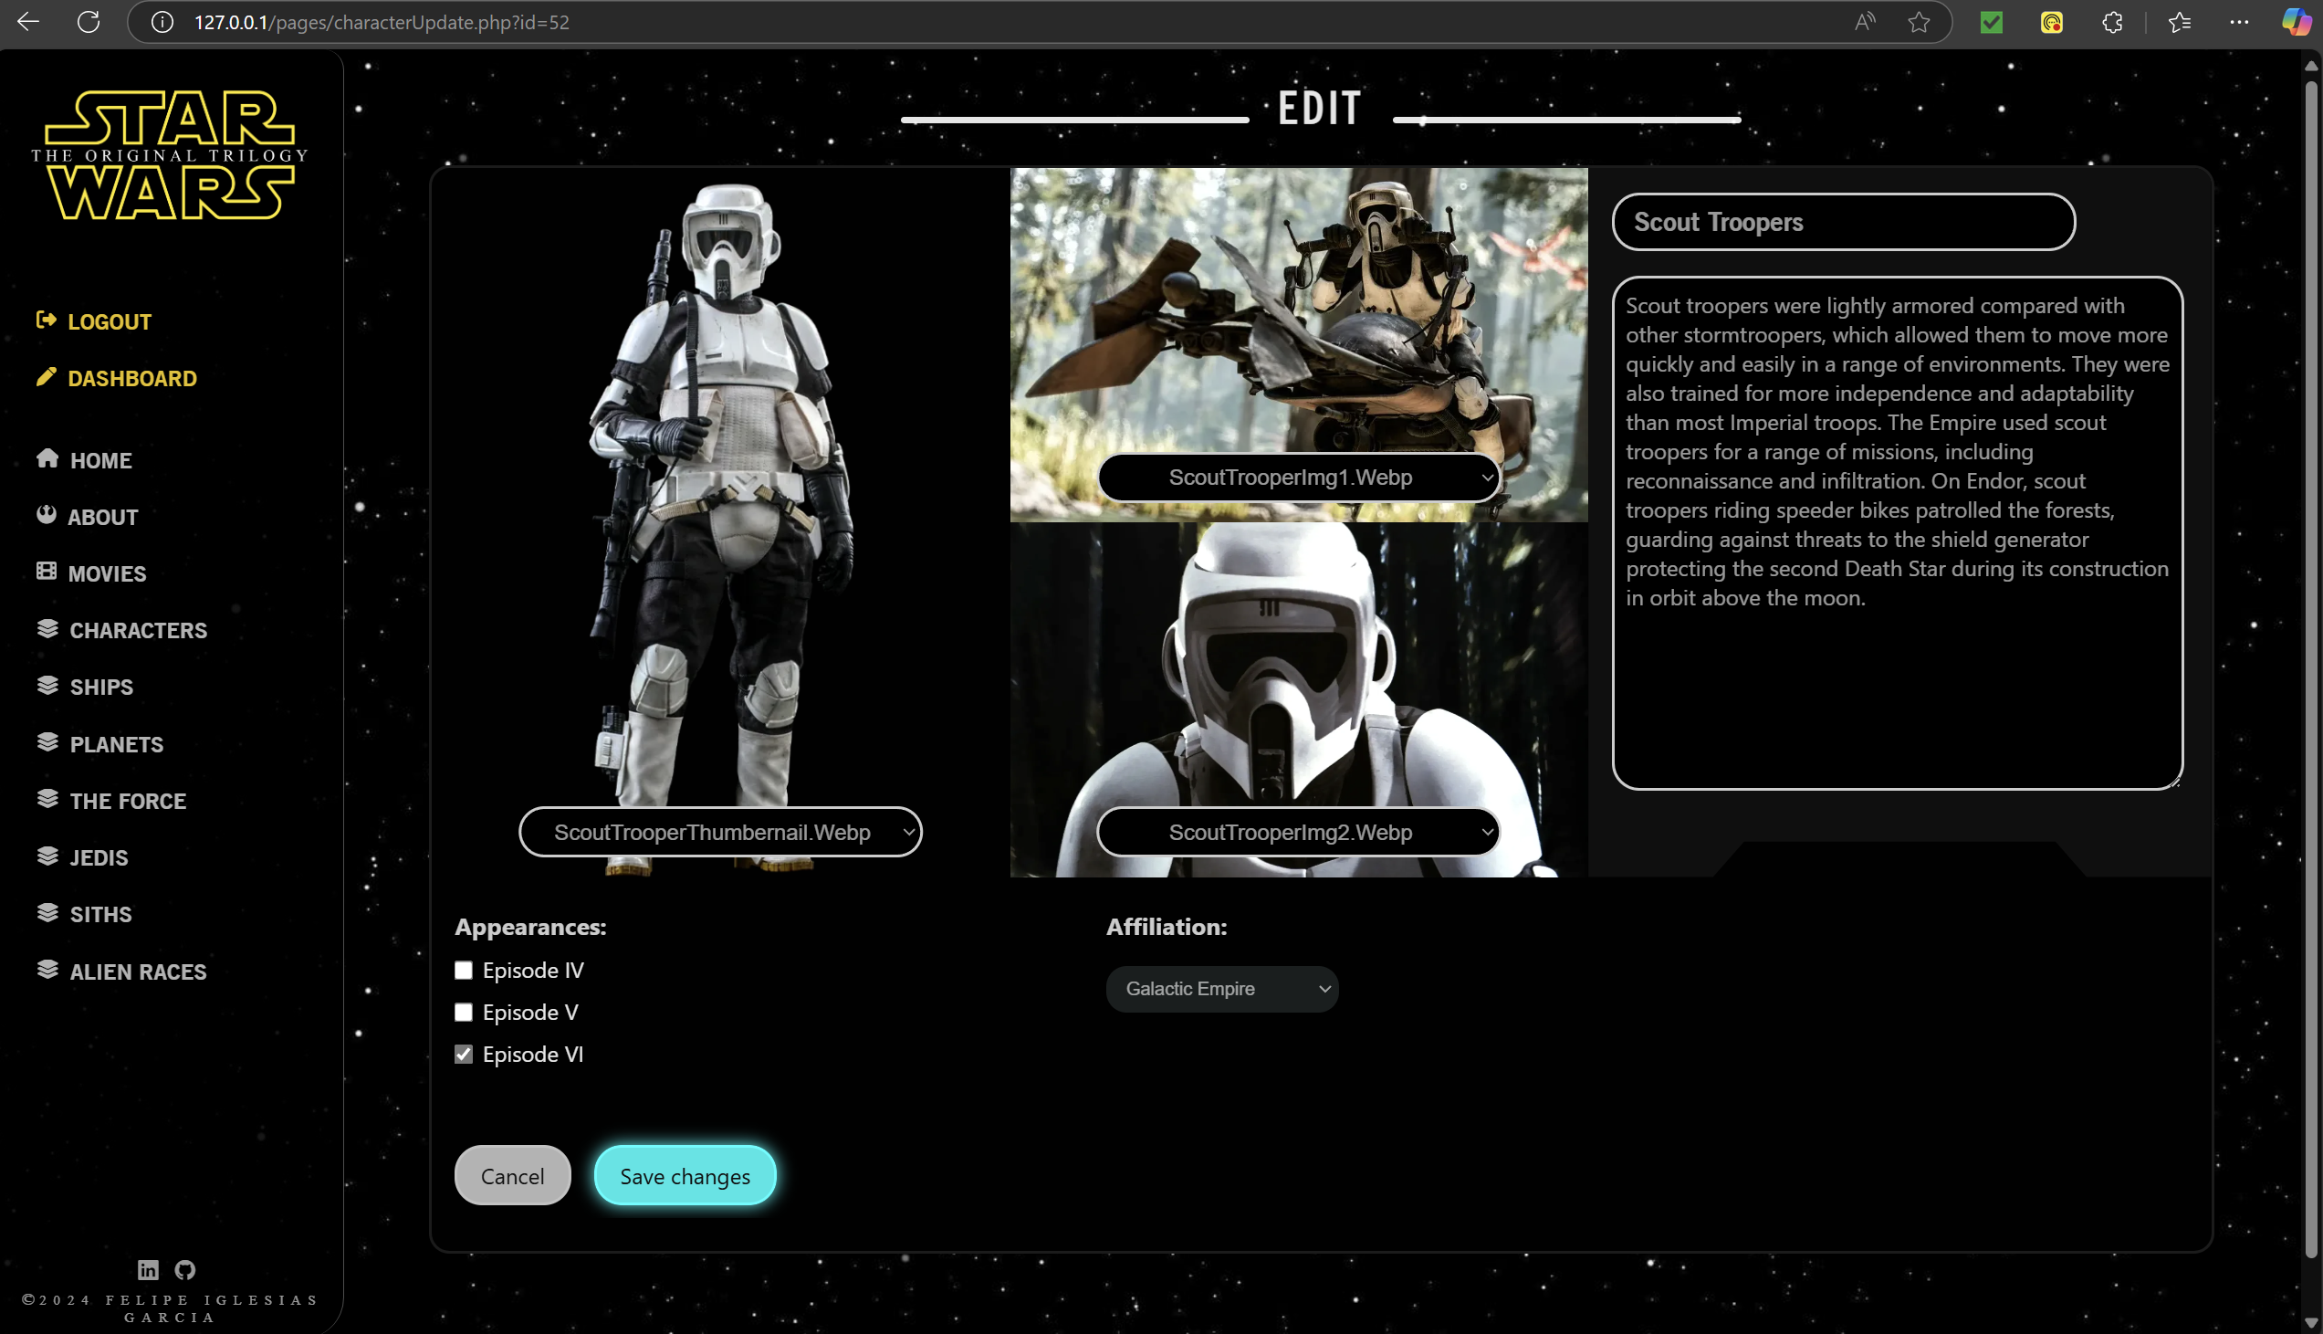
Edit name
Edit images
Edit biography
Edit appearances
Edit affiliations

Slide 19
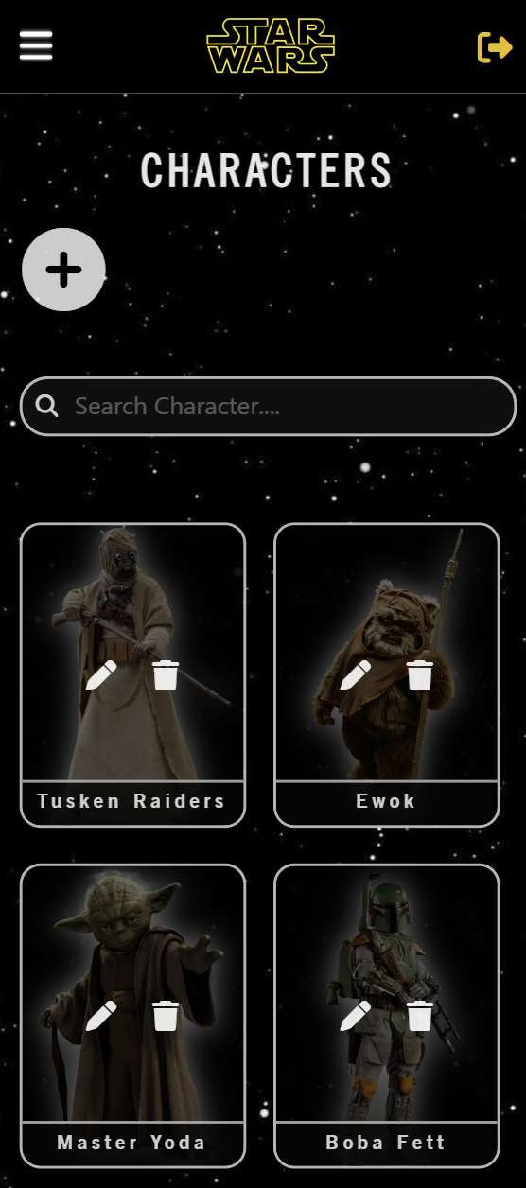
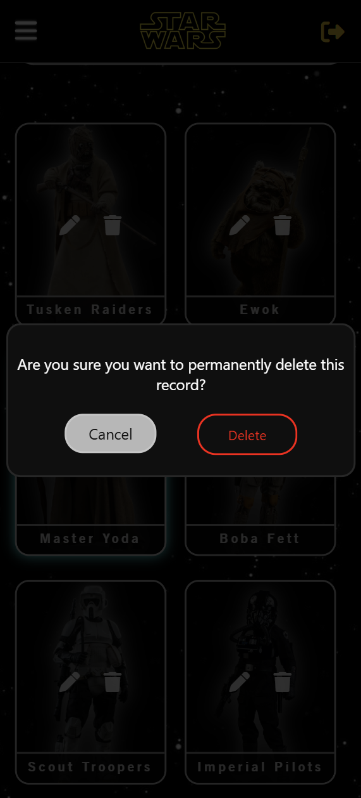
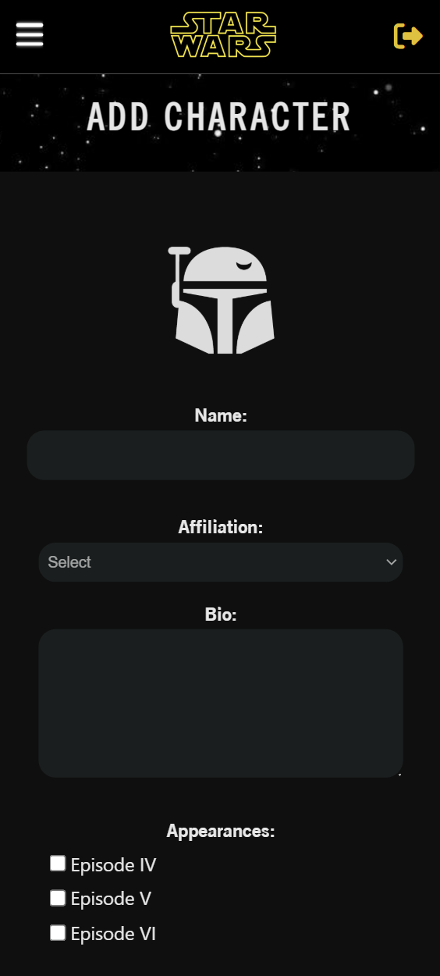
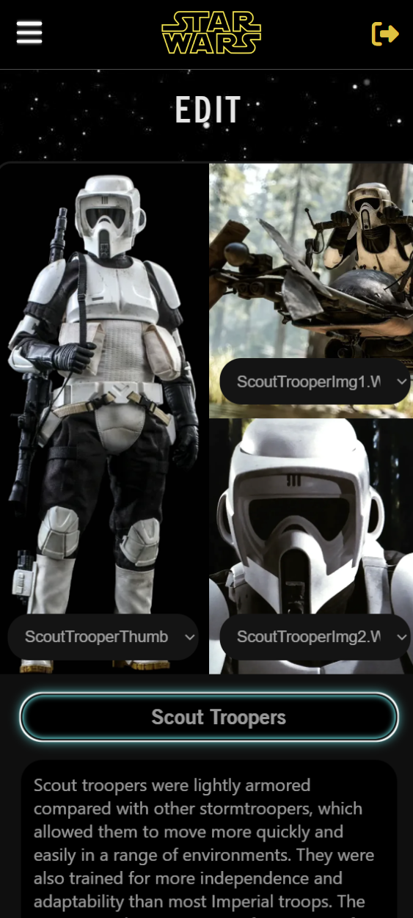
Mobile view
Model: iPhone 16

Slide 20
LEGISLATION

Slide 21

Australian Privacy Principles
APP 1
Open and transparent management of personal information
APP 8
Cross-border disclosure of personal information
APP 11
Security of personal information
APP 12
Access to personal information
APP 13
Correction of personal information

